Slide 1
Talk-Line
Grades 3-5

Slide 2
Who Can You Talk To?
If you are hurting yourself/thinking about hurting yourself or being hurt by someone else, you should tell a safe adult, such as:
Your teacher
Your school counselor
Your parent
Talking to someone you trust is the fastest way to stay safe and get help.

Slide 3
But what if no one is available?
What if you don’t feel like you can talk to anyone, even someone you trust?
Talk-Line is available for students in Grades 3-5. However, Talk-Line is for a specific kind of help.

Slide 4
What is Talk-Line?
Provides help for students who are thinking about hurting themselves.
Provides help for students who are hurting themselves.
Provides help for students who are being hurt by someone else.

Slide 5
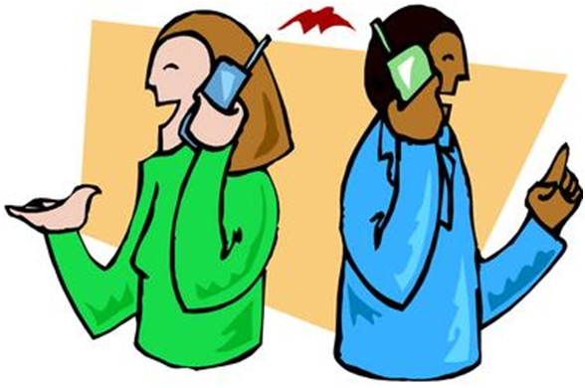
Talk-Line Provides
A safe person you can talk to who will listen, give you help to stay safe, or assist you in getting help.

Slide 6
Talk-Line Does Not Provide
Help with homework
911 response where the police or fire department are needed.

Slide 7
What Happens When You Call Talk-Line?
Explain why you are calling.
A trained person will listen to you and try to help you or get the help you need.
You may be asked your name, grade level, age, and where you go to school.

Slide 8
Don’t Prank Call Talk-Line
A prank call to Talk-Line takes time away from other students who really need help.
Prank calls may result in the police arriving at your home or school.

Slide 9
The Same Counseling Rules Apply to Talk-Line. Talk-Line will only share what you talk about if:
Someone is hurting you
You want to hurt someone
You want to hurt yourself
You give permission to share with another trusting adult

Slide 10
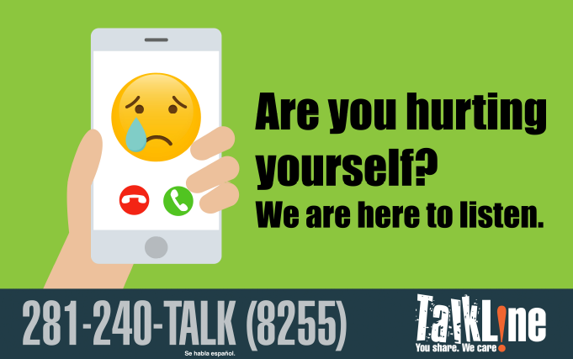
You May See These Talk-Line Posters in the 3rd, 4th, and 5th Grade Areas

Slide 11
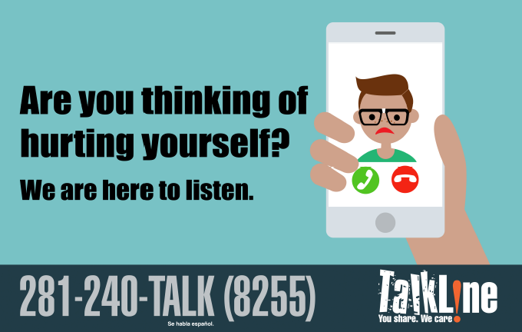
You May See These Talk-Line Posters in the 3rd, 4th, and 5th Grade Areas

Slide 12
Questions?

